Slide 1

A diverse world for players for all kinds
A Cluster Segmentation based on players’ behavior
Charlie Chen, Chenyang Meng,
Jiewu Rao, Natalie Ito

Slide 2

What’s GTA Online
A multiplayer online game mode based on GTA game series
Create a dynamic and ever-evolving online universe for up to 30 players
Continuously release DLC for more contents

Slide 3


Business model of GTA Online
GTA Online is included free with all copies of GTA 5 :
No further charging for the online mode
A standalone version of GTA Online is available on PS5 from 15th March, 2022
GTA+:
GTA Online’s premium membership program
deliver member-exclusive benefits and rewards each month
Shark Cards:
Cash is king in this town.
Exchange real money for virtual money
Basically, the exchange rate is $500,000 in GTA currency for $10 USD

Slide 4








Profile our Players
Activity enthusiast or freewheeling player？
Buyer or Saver?
GTA Online is designed for players of all kinds
…
Loyal User or New Users?
Notes:
When we put utest platform into the human cloud framework, we found that uTest is a typical governor crowdsourcing platform. In the process of software testing, utest is responsible for the entire testing process, including recruiting testers, controlling the testing process, and finally presenting the test results to customers. But the testers complain that they are lacking communication methods with the product developer and manager. When testers find a bug or issue, they can upload what they found to the “issues” part in the project section, then the bug report is evaluated by the uTest’s Test Team Leads whose members are promoted from testers who may not have much software knowledge to identify the prioritization of bugs. As a matter of fact, our suggestion is that uTest can change the full-service govenor platform to a combination of both the governor and aggregator frameworks. uTest may let the client’s developers be part of the evaluation team. The platform needs to allow developers to directly see testers’ feedback to make timely adjustments. Apart from that, they should adjust the front-end process accordingly for different customers. For clients who are not code-based providers, full-service is vital. For clients who are familiar with the testing process, the better way is to get customers involved in the testing process and work collaboratively.

Slide 5
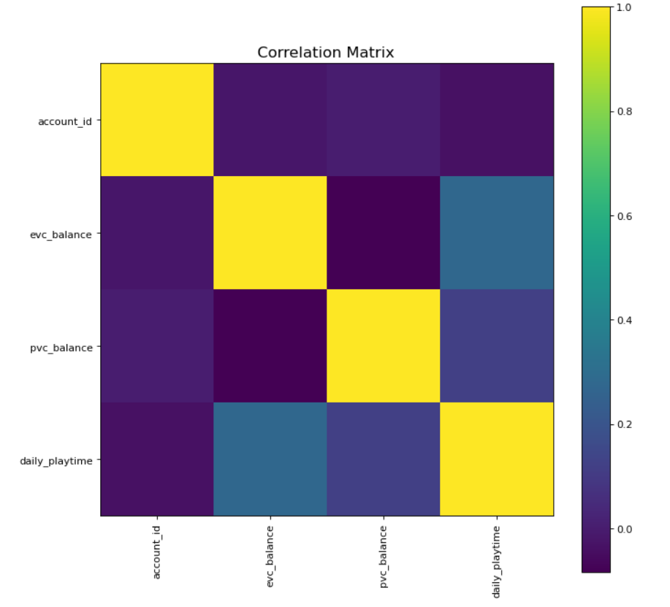
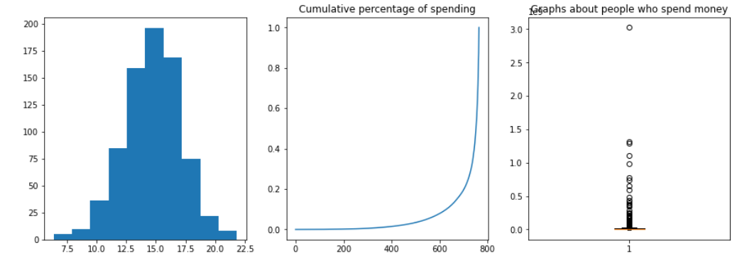
First Look at Data
Notes:
visualize.ipynb

Slide 6
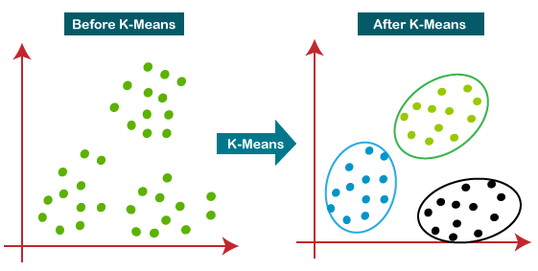

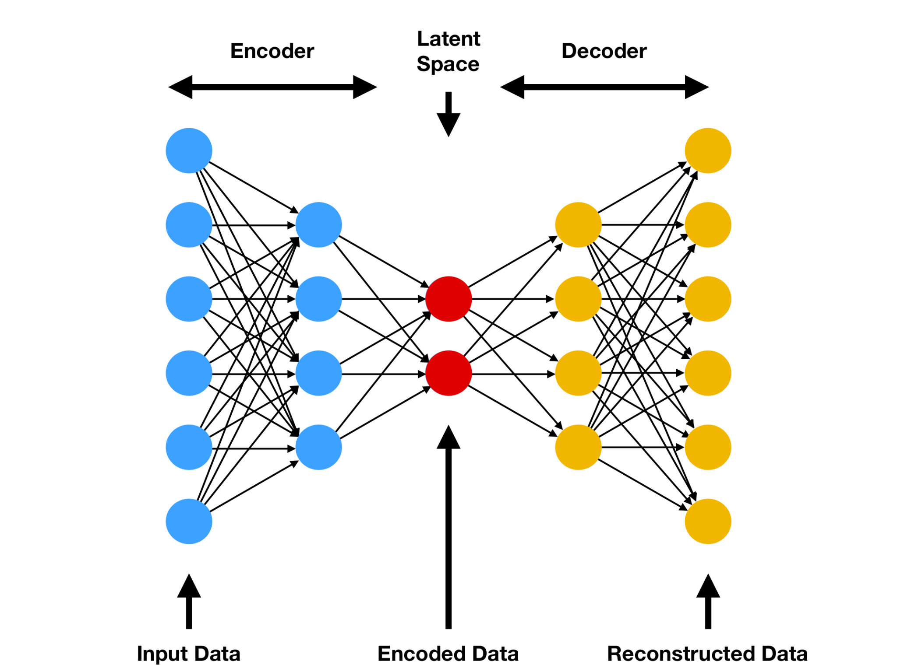
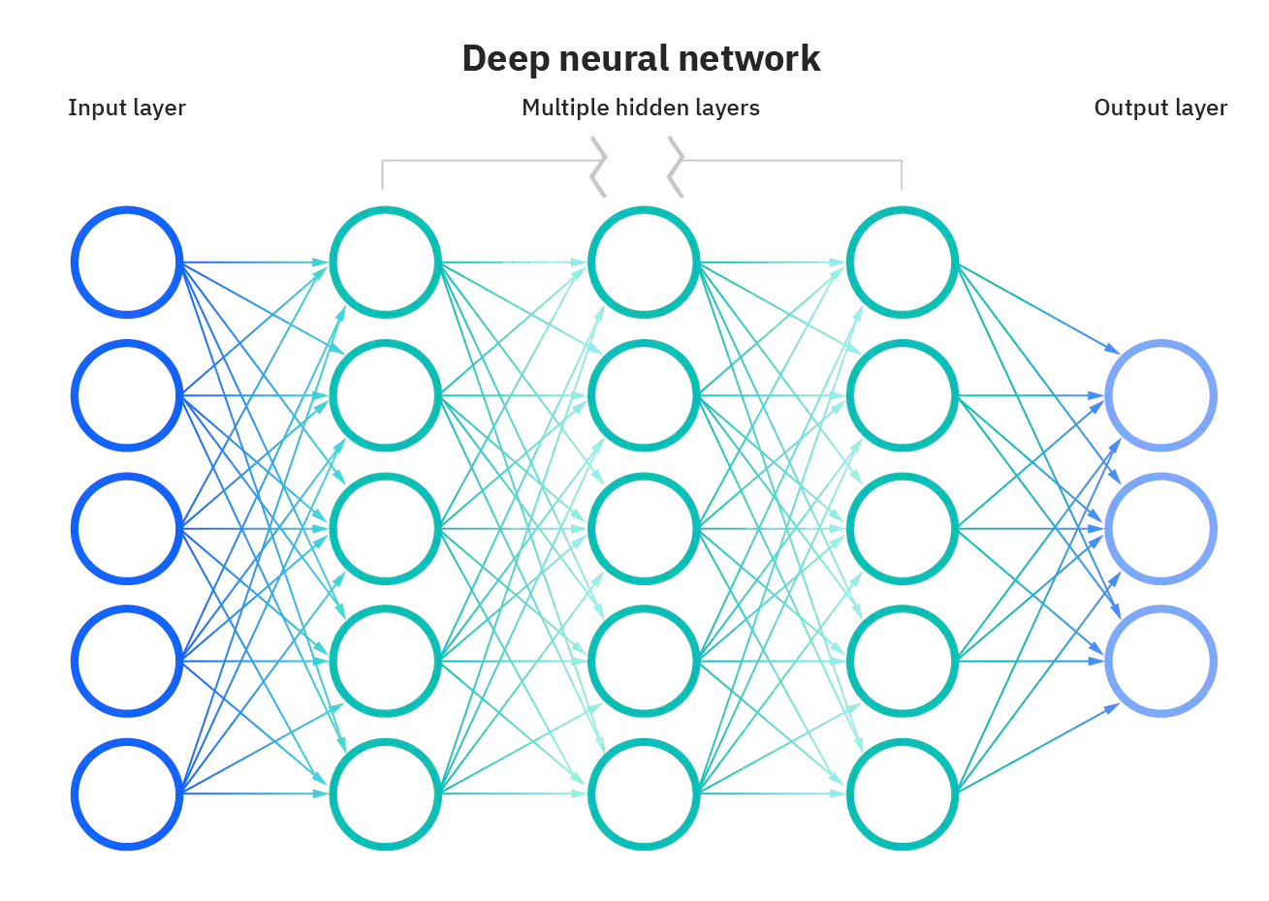
Our Models
Notes:
https://lightgbm.readthedocs.io/en/latest/index.html
https://www.google.com/url?sa=i&url=https%3A%2F%2Fwww.analyticsvidhya.com%2Fblog%2F2021%2F04%2Fk-means-clustering-simplified-in-python%2F&psig=AOvVaw0C7PtyCPSMJ7U1_KAptUcT&ust=1651418985449000&source=images&cd=vfe&ved=0CAkQjRxqFwoTCPjblqaNvPcCFQAAAAAdAAAAABAD
https://www.compthree.com/images/blog/ae/ae.png
https://www.google.com/url?sa=i&url=https%3A%2F%2Fwww.ibm.com%2Fcloud%2Flearn%2Fneural-networks&psig=AOvVaw3p6icZVqzpjT3zpS5kIP9m&ust=1651419381978000&source=images&cd=vfe&ved=0CAkQjRxqFwoTCIDdv9-OvPcCFQAAAAAdAAAAABAD

Slide 7
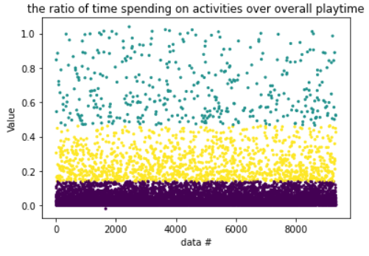
Activity VS Free style
Some players prefer to do the activities in the games, while others prefer explore the game freely
players who love doing activities
players who love exploring the world freely
Notes:
When we put utest platform into the human cloud framework, we found that uTest is a typical governor crowdsourcing platform. In the process of software testing, utest is responsible for the entire testing process, including recruiting testers, controlling the testing process, and finally presenting the test results to customers. But the testers complain that they are lacking communication methods with the product developer and manager. When testers find a bug or issue, they can upload what they found to the “issues” part in the project section, then the bug report is evaluated by the uTest’s Test Team Leads whose members are promoted from testers who may not have much software knowledge to identify the prioritization of bugs. As a matter of fact, our suggestion is that uTest can change the full-service govenor platform to a combination of both the governor and aggregator frameworks. uTest may let the client’s developers be part of the evaluation team. The platform needs to allow developers to directly see testers’ feedback to make timely adjustments. Apart from that, they should adjust the front-end process accordingly for different customers. For clients who are not code-based providers, full-service is vital. For clients who are familiar with the testing process, the better way is to get customers involved in the testing process and work collaboratively.

Slide 8
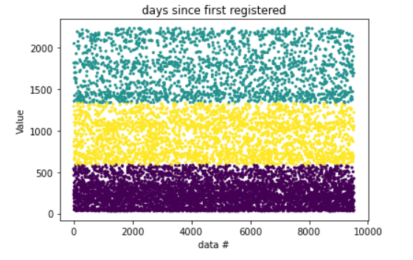
Loyal User VS New Users
Some are loyal users who have played for a long time while others are new users
loyal users
new users

Slide 9
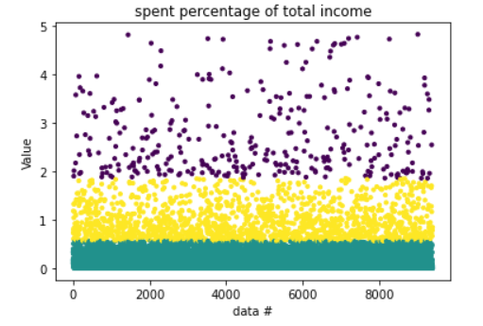
Buyer VS Saver
Some people prefer buy more things while others prefer save money
players who spend more money
players who prefer save money

Slide 10
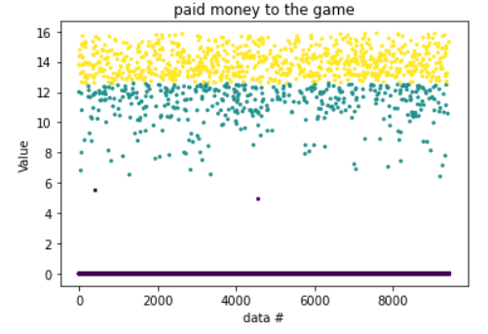
Pay VS not Pay
Some people will pay money to the game while others will not
players who pay
players who don’t pay
Note: the y-axis is log scale!

Slide 11
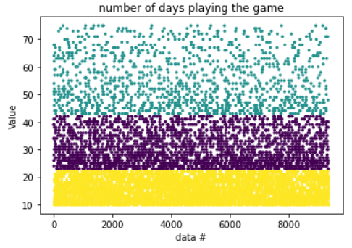
Frequent VS not Frequent Player
Some people frequently play games while others only play occasionally
frequent player
infrequent players

Slide 12
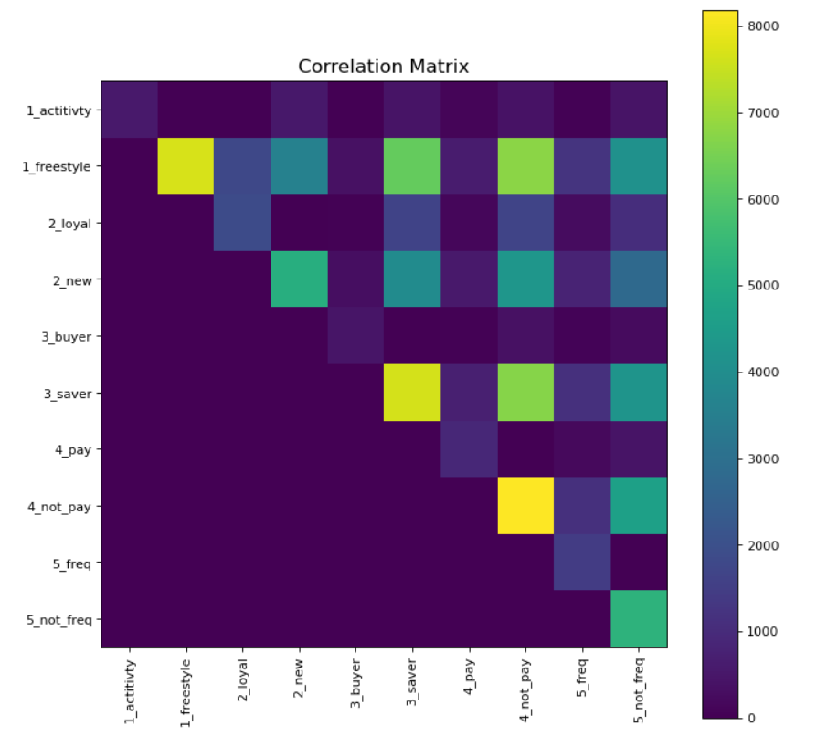
Cluster our players
Players who tend to freestyle 1. don’t pay
2. and would rather save
Players who do not frequently log in to GTA online
not willing to pay for the game
tend to be a saver

Slide 13
What should Rockstar do?
Rockstar may send advertising emails or send extra coupons for not frequently attending players. The more active they are as a GTA online player the more they are likely to pay.
For Rockstar, they need to release some more attractive DLC and activities so that more players are willing to attend the activities and spend more money both in the game and in reality for the GTA online.
For non-freestyle players, Heist is the most popular activity type - suggesting that people enjoy collaborative tasks. Therefore, Rockstar may incorporate more collaborative features or add/improve Heist tasks.

Slide 14
Future Insights
Other data that would be useful for the analysing team:
Demographics, particularly age groups (categorization example: adolescents (17-18), young adults (18-25), older adults (25+)
Differences in time availability, disposable money, and playing habits, etc.
Player’s general location (country)
Although privacy is something to consider, analyzing geographical location and adjusting the game perks relevant to specific country or culture may help reach the players of all kinds from different countries.
What to dig deeper:
How much revenue should I expect new customers to generate? Based on the historical data, we can predict the value (numerical) that the customer will bring to the company.
As the Rockstar website declares, GTA Online is designed for players of all kinds. So it is vital for the analysing team to Profile the players and find their typical behavior.

Slide 15
Thank you!

